Slide 1
NMI3
The Integrated Infrastructure Initiative for Neutron Scattering and Muon Spectroscopy
FP7-CAPACITIES program
Combination of CP and CSA
Current FP7 Grant Agreements No.:
NMI3-I (No. 226 507)
NMI3-II (No. 283 883)

Slide 2
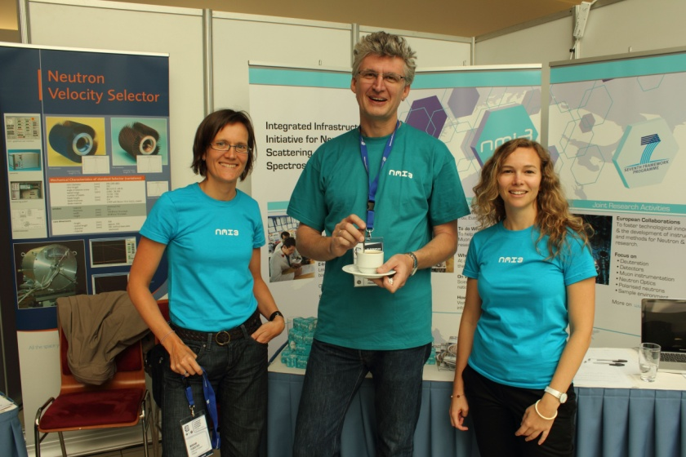
Networking and dissemination
Access
Programme
Facilities
JRAs
New JRAS
Continuing JRAs
Partners
Education – Schools and E-learning
Dissemination – Website, Newsletter and PR network
Meetings / Reports

Slide 3



NMI3 – a bit of history
  Under FP5 : Start as EU Round –Table (2000 – 2003)
  Under FP6 : Birth of Integrated Infrastructure Initiative for Neutron Scattering and Muon Spectroscopy (2004 – 2008)
  Under FP7 :
  NMI3-I from Feb. 2009 to Jan. 2013 (9.9 million €)
  NMI3-II started Feb. 2012 lasts till Jan. 2016
  ➔ 18 partner organisations from 12 countries, including 8 facilities
  ➔Total budget NMI3-II: 13.35 million €

Slide 4
Access
  6.7 million euros distributed over 10 institutions (8 facilities)
  Funding for new / young researchers based at institution in European member or associated state
  Application via resp. facility user office
  Proposal evaluation based on scientific excellence (international panels)
Programme

Slide 5
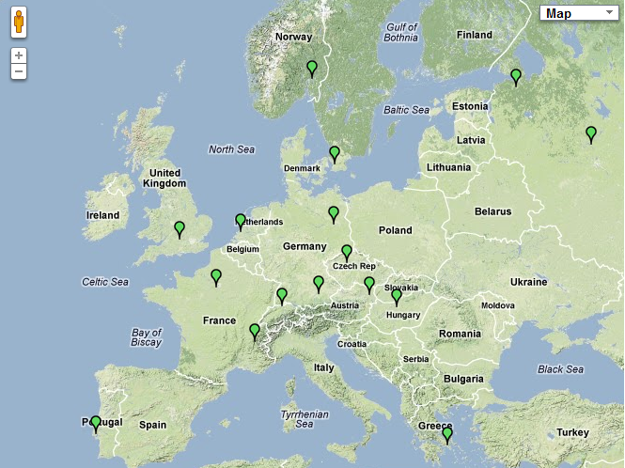










Access programme – member facilities

Slide 6
Access
Facilities
  Neutrons:
  FRM II, HZG, JCNS (Munich)
  HZB (Berlin)
  LLB (Paris)
  ISIS (Rutherford)
  PSI (Villigen)
  BRR (Budapest)
  RID (Delft)
  NPI (Prague)
  ILL (coordinating facility)
  Muons:
  ISIS
  PSI

Slide 7
Joint Research Activities – 4.2 million €
New topics:
  Imaging ( Nikolay Kardjilov, HZB)
  Advanced Methods and Techniques (Phil Bentley, ESS)
  Advanced tools for Soft and Biomaterials (Annie Brulet, LLB)
Continuing topics:
  Detectors (Nigel Rhodes, ISIS)
  Muons (Steve Cottrell, ISIS)
Partners:
  ILL, CEA (both France), STFC (UK), TUM, FZJ, HZB, HZG (all Germany), PSI (CH), MTA EK, Wigner RCP (both Hungary), TUD (Netherlands), NPI (Czech Rep.), CNR (Italy), UCPH, DTU (both Denmark), University Zaragoza (Spain), ESS (Sweden)

Slide 8
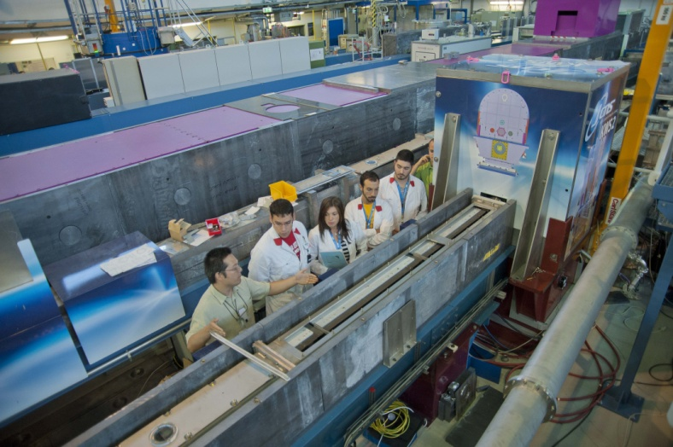
Networking and Dissemination
1.8 million euros for networking and dissemination
Education – Schools (450k euros)
  Umbrella of 14 supported schools
  JCNS school, Oxford neutron school, HZG summer school, PSI summer school, CETS, Baltic school (Latvia), Bombannes, Fan du LLB, JACA (Zaragoza), SISN school, ISIS muon school, Fullprof, Berlin school, HERCULES

Slide 9
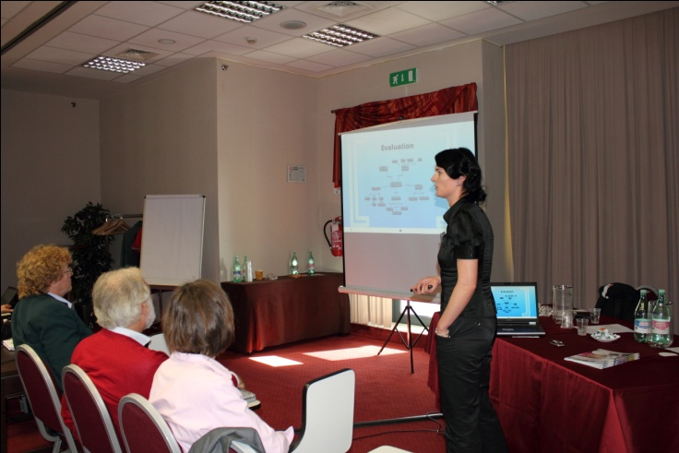
Networking and dissemination
Education - E-learning
  Virtual Neutrons for teaching project
  Team at University of Copenhagen and Riso – L. Udby, K. Lefmann, P. Jensen, P. Willendrup
  Team at FRM II/TUM – O. Kreischer, J. Neuhaus
  Hosted by FRMII/TUM
  Accessible from NMI3 website: www.nmi3.eu
  Lessons, live simulations, exercises, quizzes & forums

Slide 10
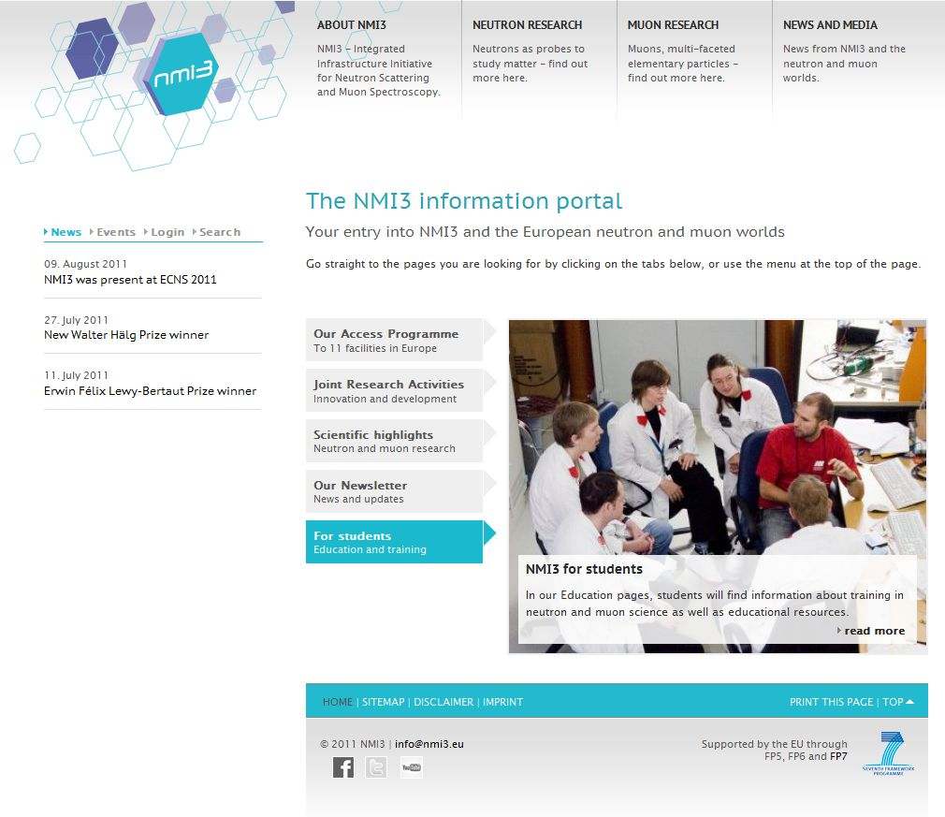
Networking and dissemination
Dissemination – New website
  New website launched in November 2011: www.nmi3.eu – please register!
  Modern, easy to navigate, functionalities: Calendar, maps of neutron and muon sources, timeline of NMI3, neutron and muon history
  Instrument finder being developed to replace old Pathfinder – will be simpler
  Developed by O. Kreischer and J. Savin at FRM II

Slide 11
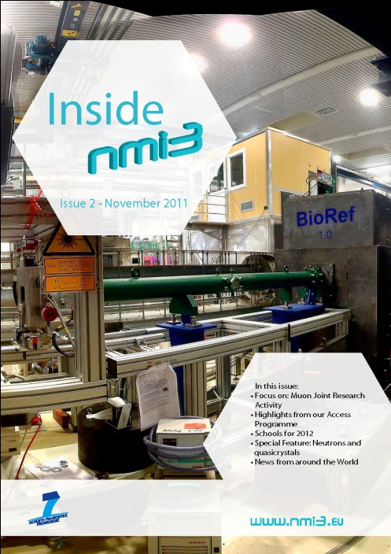
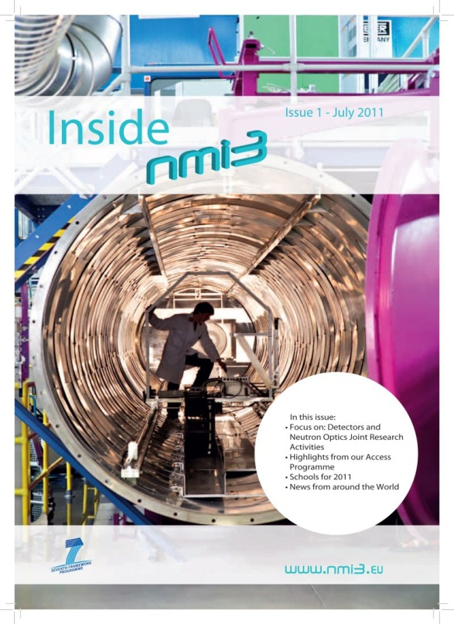
Networking and dissemination
Dissemination - Newsletter
  Newsletter published twice a year
  need to register to receive it by email
  Printed and distributed at facilities, schools, conferences etc
  Downloadable from the website
  Updates on JRAs,Scientific highlights, News from facilities, New from around the world…

Slide 12
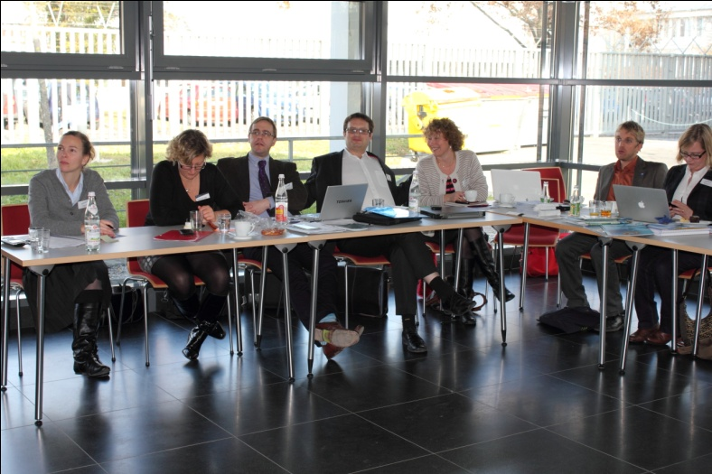
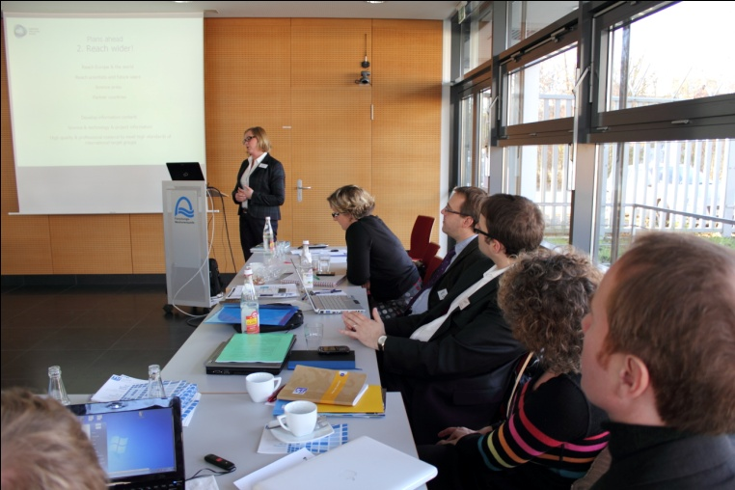
Networking and dissemination
Dissemination – PR network
  ´European Neutron and muon PR network´ set up by J. Savin (NMI3 Dissemination manager)
  Regular meetings (twice a year)
  Aim: Integration of PR activity of big and small facilities, increase visibility of neutron and muon research in European media
  ➔ neutronsources.org

Slide 13
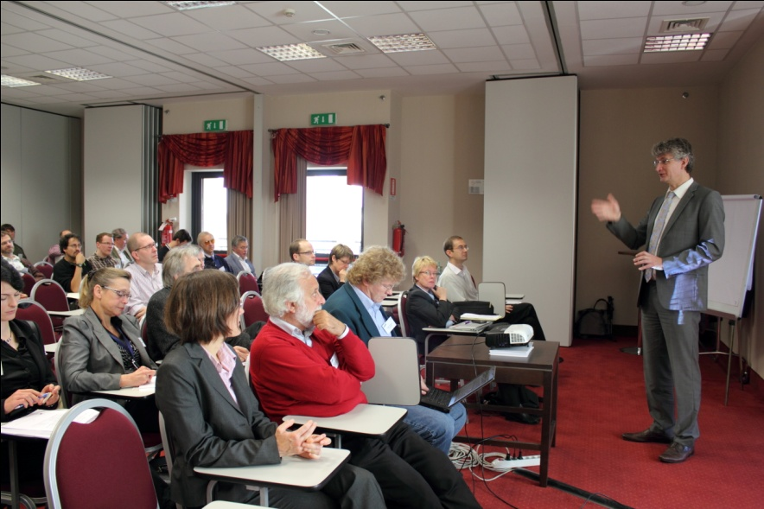
Meetings
General Assemblies
  Roughly every 16 months
  Everyone involved can attend
Business meetings
  Every year
  Only work package leaders attend and report
JRA meetings
  As needed during the project

Slide 14

Reporting
Internal monitoring report
  every 6 months
  To be filled by WP leaders
Periodic Reports ➔ EC
  Technical and financial part
  After month 18 and month 36
Final report ➔ EC
  Technical and financial part
  Use & dissemination of foreground
  Societal implications
  After month 48

